Slide 1


Turning a Stepper Motor with a Joystick
Arduino with C Programming
ELECTRICAL ENGINEERING AND COMPUTER SCIENCE, COLLEGE OF ENGINEERING AND PHYSICAL SCIENCES
Notes:
Updated 13 Jun 2024 by Noah Mulvaney

Slide 2
Goals
Take analog values from a joystick and convert them to digital values and use them to rotate our stepper motor
Use the ULN2003 Stepper Motor Driver Module to easily attach and control the stepper motor

Slide 3
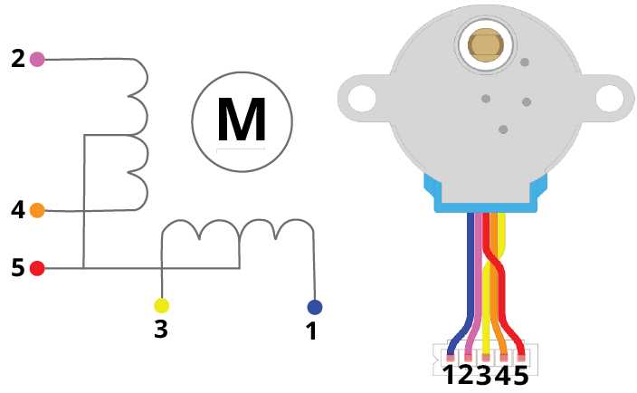
What is a Stepper Motor?
A Stepper Motor is controlled with electromagnetic fields
The 28-BYJ48 Stepper Motor contains two coils, a magnet in the middle attached to the rotor, and ‘teeth’ on the stator of the motor
Each time the motor moves from one ‘tooth’ to another we call that a step
This Stepper Motor has 32 steps in one revolution
When sending an electric pulse to a coil we can induce a magnetic field that attracts the magnet therefore turning the rotor

Slide 4
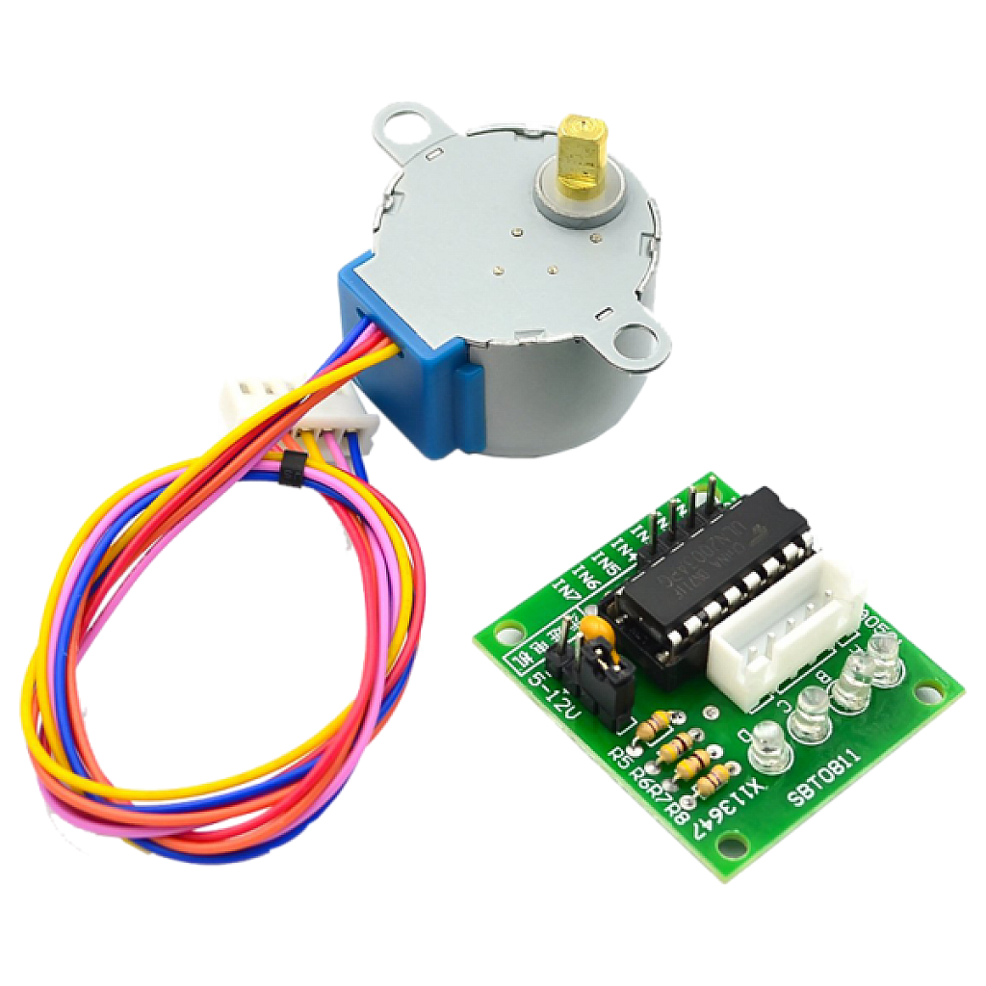
What is a Stepper Motor?
The ULN2003 Stepper Motor Driver Module allows us to control the stepper motor with ease
Gives us organized connections from the Arduino to the motor

Slide 5
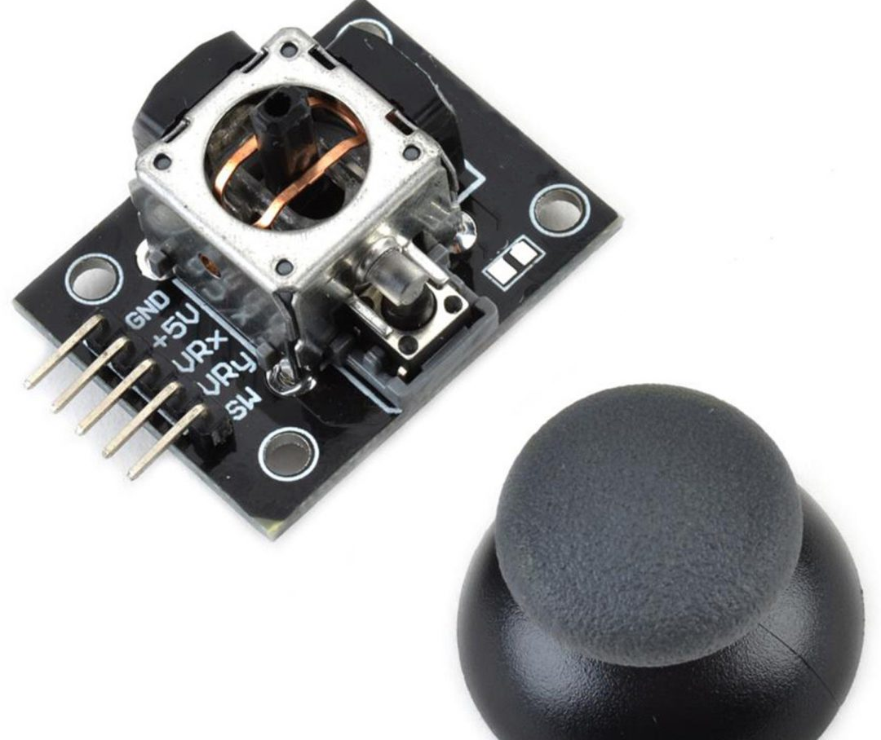
What is a Joystick?
A joystick is made up of two potentiometers and a pushbutton
There are two potentiometers for each axis (x and y), we will only be using the x axis potentiometer to rotate the stepper motor
A potentiometer is a variable resistor, the potentiometers in this joystick are connected between five volts and ground
When our potentiometer is at full resistance, we have a minimum value and vice versa
When pushing down the joystick you enable the pushbutton

Slide 6
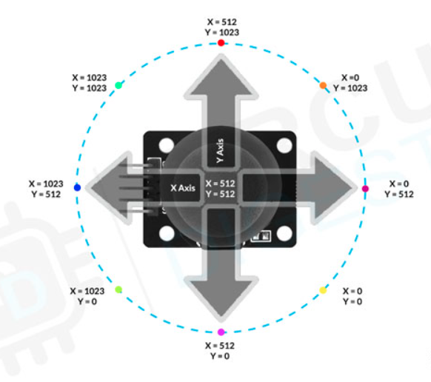
What is a Joystick?
When we move the joystick all the way in one direction, we are either reading five or zero volts
Instead of reading a value between five and zero volts to the Arduino, we need to put these numbers to a digital value (0-1023) using the built in ADC (analog-to-digital converter)
We can then use this digital value in our Arduino code in whatever way we want

Slide 7
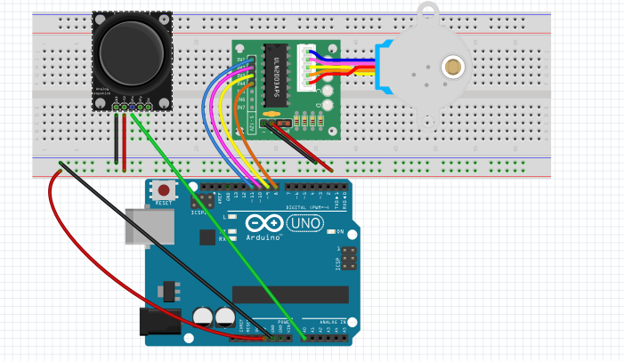
Circuit Diagram
Arduino Pins
  Pin 11: IN1
  Pin 10: IN2
  Pin 9: IN3
  Pin 8: IN4
  Pin A0: VRx
11 10 9 8
A0

Slide 8
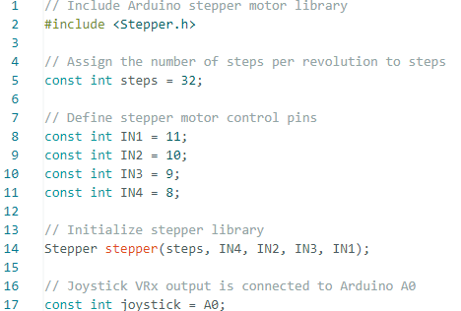
Completing the Code

Slide 9
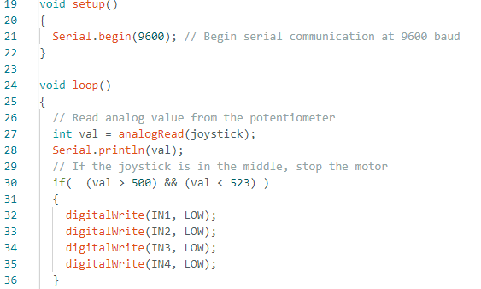
Completing the Code

Slide 10
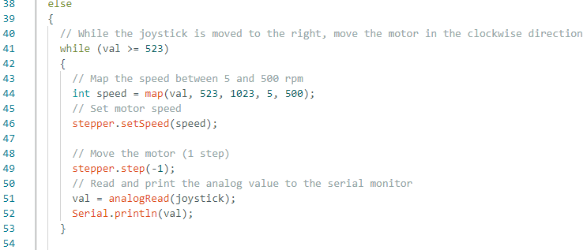
Completing the Code

Slide 11
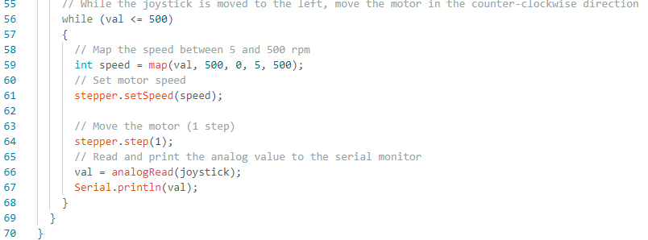
Completing the Code

Slide 12

Test it Out!
Open your serial monitor and observe the values shown when moving the joystick

